Slide 1
Just-In-Time Testing
Robert Sabourin
President
AmiBug.Com, Inc.
Montreal, Canada
rsabourin@amibug.com

Slide 2
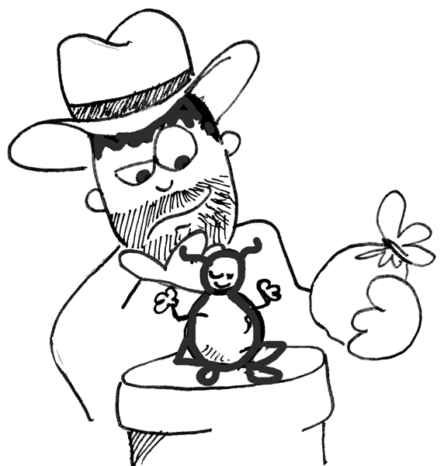
Overview
  Introduction
  Some Philosophy
  Bug Flow
  Testing Ideas
  Test Triage
  Developers
  Testing Just In Time
  Platforms
  Exploratory Testing
  Checklists
  Scenarios
  Status
  Bibliography

Slide 3

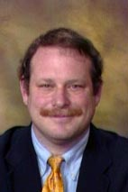
Just In Time Testing
Robert Sabourin , Software Evangelist
President
AmiBug.Com Inc.
Montreal, Quebec, Canada
rsabourin@amibug.com

Slide 4
Just-In-Time Testing
Some Philosophy

Slide 5

Fundamental Question
How do you know when you are finished?

Slide 6

Crosby on Quality
“Quality is defined as conformance to requirements”
“Quality is not a measure of GOODNESS”
  Phil B. Crosby, Quality is Free

Slide 7
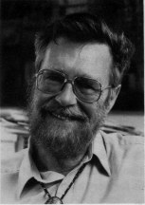
Edsger W. Dijkstra
“Program testing can be used to show the presence of bugs, but never to show their absence”

Slide 8

Boris Beizer
“Why software has bugs – the fundamental problem – Programming is a bitch.”
    The Frozen Keyboard - 1986

Slide 9

Ken Blanchard
“Feedback is the breakfast of champions!”

Slide 10
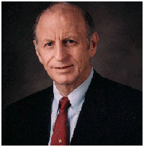
Watts S. Humphrey
“… the job of the software engineer is to deliver high-quality software products at agreed cost and schedule …”
“… even the most experienced software engineer injects about one defect for ten lines of code …”

Slide 11

C. Northcote Parkinson
Parkinson’s Law:
“…work expands so as to fill the time available for its completion…”

Slide 12
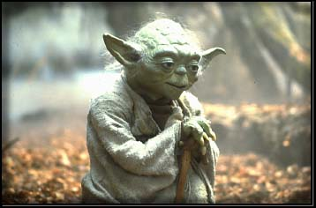
Yoda
"No! Try not, Do. Or do not.
There is no try."

Slide 13

Steve Covey
“…begin with the end in mind …
“…first things first …"

Slide 14

Purpose of Testing
Common definition:
  To find bugs before our customers do!
Broader definition:
  The role of testing is to provide objective input to facilitate business decisions!
  Keeps stakeholders aware of all issues or concerns that relate to shipping a product!

Slide 15
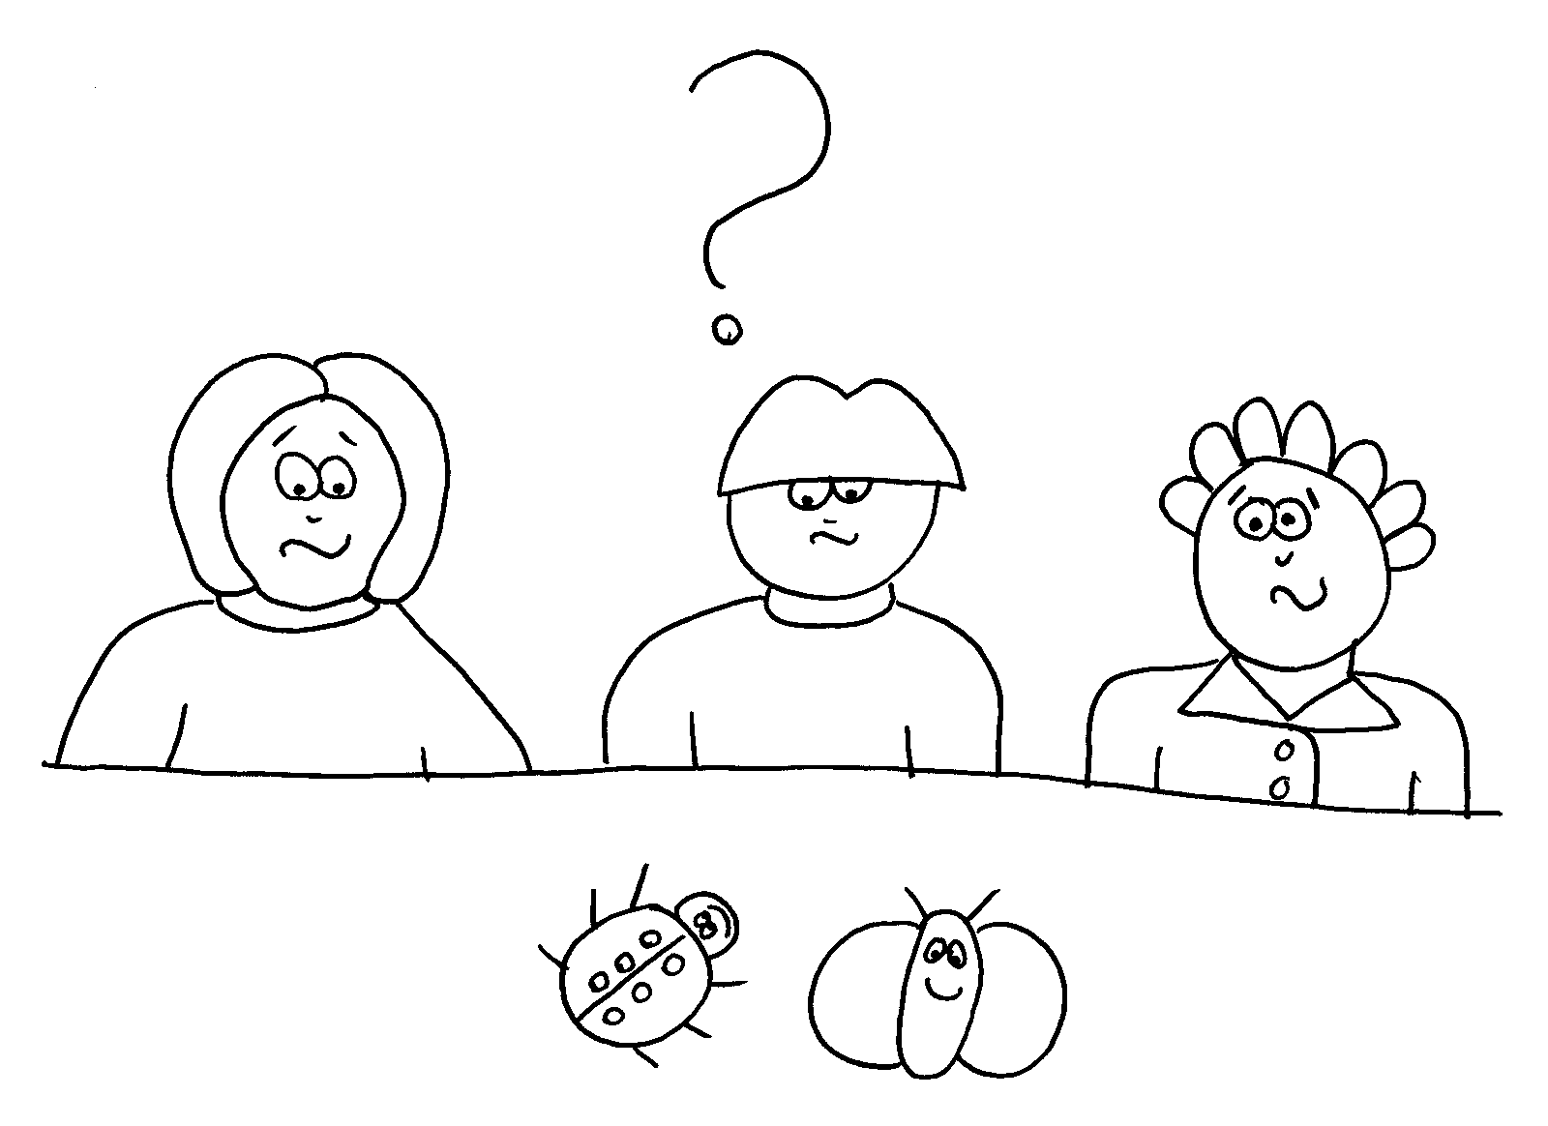
Bug Defined
To make our job more fun, whenever we have a concern with software, we call it a “bug”.

Slide 16
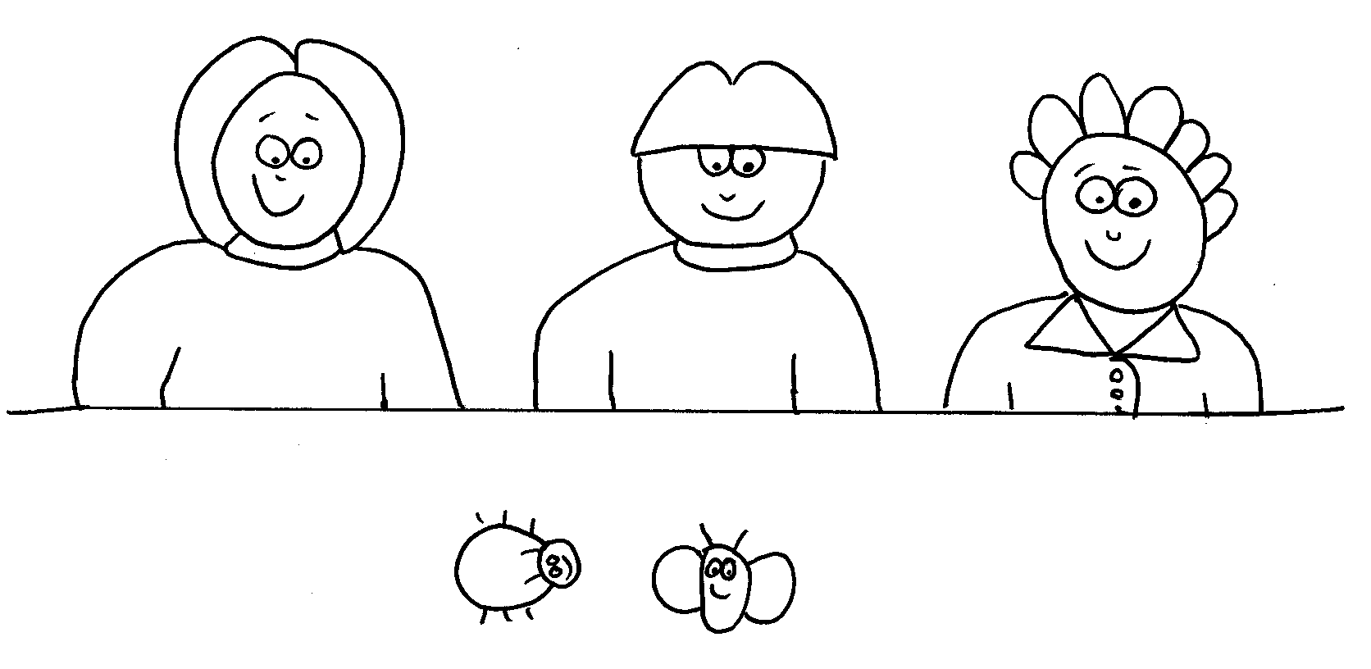
Just-In-Time Testing
It’s all about people! (and the occasional bug too)

Slide 17
Just In Time Testing
Get Ready, Get Set,
Cause here it comes

Slide 18




Just-In-Time Testing
Turbulence

Slide 19
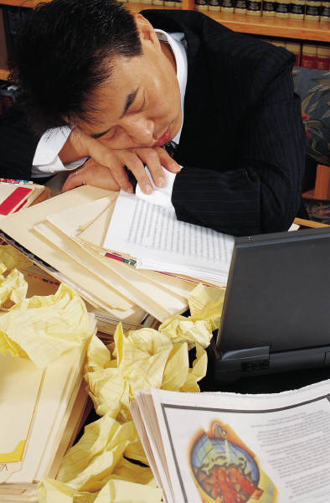

Just-In-Time Testing
Unprepared

Slide 20
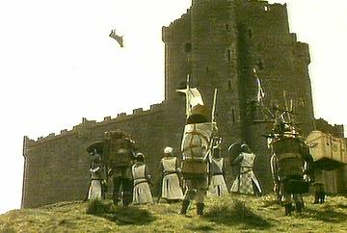
Just-In-Time Testing
So what exactly did they throw over the wall?

Slide 21
Getting Things Done
Metaphors
  RUTHLESS TRIAGE
  RING BELL
  WELL OILED MACHINES
Themes
  Parallelism wherever and always
  Think and test 24/7, early and always
  Chunking

Slide 22

First Things First
Begin with the end in mind
  Gain Consensus
    Goals
      How do we know we are finished?
    Purpose
      Why are we doing this project?
      How will be react to change?
    Meaning
      What is a bug?
      What is a test?

Slide 23
Just In Time Testing
Bug Flow

Slide 24
Bug Flow
We will be testing … imagine that we actually find a bug!
  What are we going to do about it?
  How will we decide?
  When should we decide how to decide?
  When should we change how we decide?
  When should we review our past decisions?

Slide 25
Bug Flow
REFUSE
Entered
Reviewed
Prioritized
Assigned
CHECK
TRIAGE
DESIGNATE
CORRECT
MANDATE
Unassigned
Fixed
Closed
CONFIRM
FAILURE

Slide 26
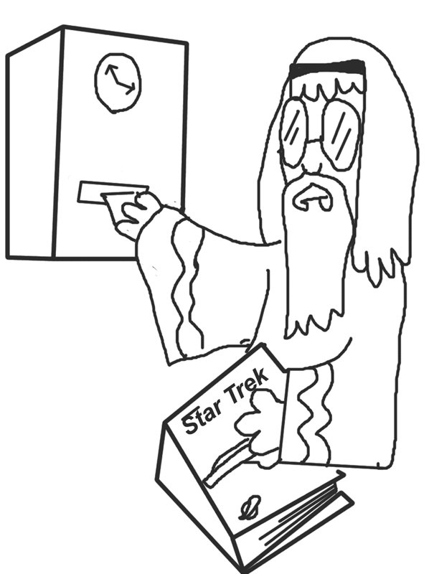
Just In Time Testing
Developers

Slide 27

Testability
Influence development team before software gets into your hands
  Can application be controlled by non-gui api for all business functions?
  Can application logging be controlled and logs viewed by testing?
  Can everything which can be set or changed be queried programmatically?
  Is there a static equivalent for dynamic guis?

Slide 28

JIT Configuration Management
Make sure that
  Developers and testers use different test servers
  Hand off to testing is based on a baseline
  Smoke test before and after delivery
  Keep previous build
  Know the last best build

Slide 29
Testing
Just In Time

Slide 30

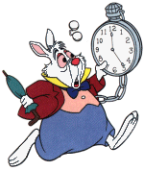
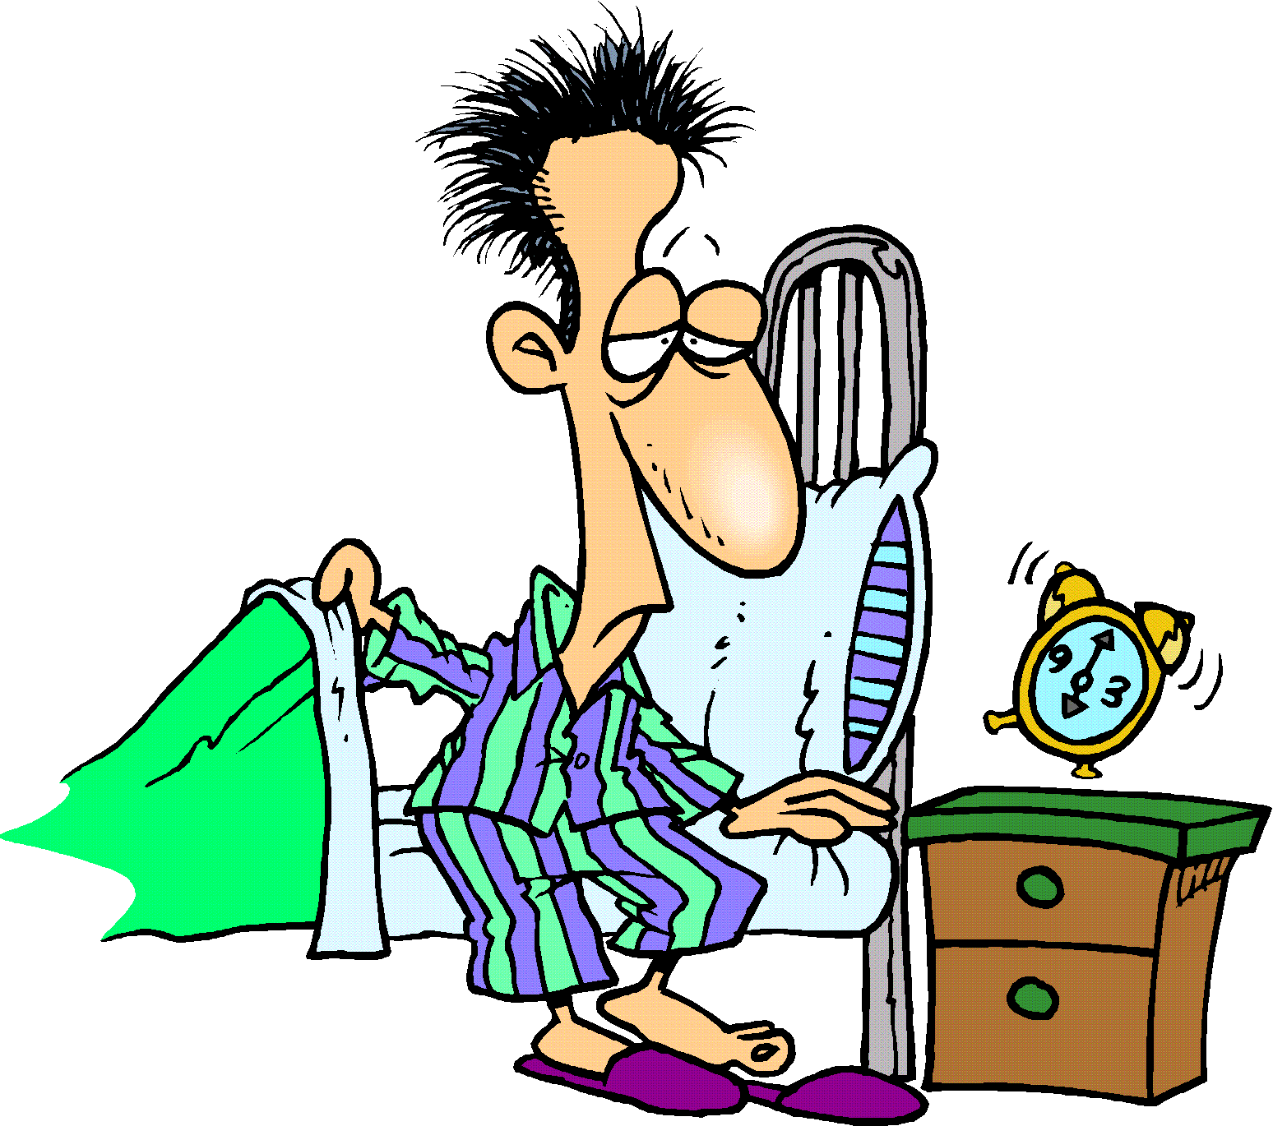
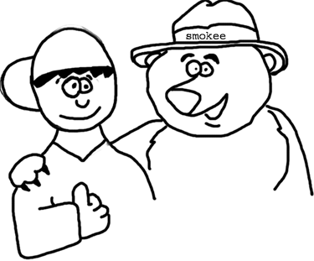
Philosophy
We have precious little time to run tests!
We must always be prepared!

Slide 31









Time

Slide 32
Getting Things Done
- Who manages them?
- How are they prioritized?
- Where can I find them?
- Are the communicated?
- Do they get reprioritized?
- Are business drivers known?
- Are technical risks known?
Development
REQ
FLOW
BUG
FLOW
- Who manages them?
- What are they?
- Where can I find them?
- When are they updated?
- Why are they changing?
- How are they evolving?
- Do we observe turbulence?
- Are builds delivered?
- Where do developers work?
- Configuration management?
- Source control? Baseline?
- Transition? Periodic?
- Smoke tests?
- Owners:Dev IT DBA SQA?
Release
Cycle

Slide 33
Getting Things Done
  Concern
  Concern
Being Prepared!
Being Prepared!
- Information Flow
- Information Flow
Corporate information Key business drivers Sales Market Finance
Corporate information Key business drivers Sales Market Finance
- Technology Flow
Architecture Technology churn Tools Techniques Training
- Requirement Flow
Defined Understood Interrupt Poll Prioritize Turbulence Status Truffle
- Bug Flow
Defined Understood Business Technical Efficient Expedient Reassess
- Test Objectives
Quality Factors Technical Risk Failure Modes Importance
- Test Strategy
Plan Analytic Exploratory Checklists Parallel Chunking Scenarios Data
- Test Organization
Scheduling Staffing Outsourcing Contractors Students
- Testing Lab
Multi-tier Server Client Platforms Swap Pattern Synchronized
- Test Status
Bug charts Test Plan Elaboration Status Pass Fail Execution Status

Slide 34
Getting Things Done
Where tests are run!
Developers Desktop
During development task assignments
Unit Testing
Development Servers
During development and integration task assignments
Unit and Integration testing
Test Lab Servers
During Integration and system test assignments
Integration and System Testing
Staging Servers
Acceptance testing
As close as possible to live technologies
Live Servers
Operational system
Site monitoring

Slide 35
Getting Things Done
Where tests are run!
Developers Desktop
- Synchronize releasing
builds from the development
team to the testing team!
Development Servers
Test Lab Servers
- Ensure a new builds passes
the Smoke Test before it
replaces the build currently
being tested!
Staging Servers
Live Servers
Never update servers when tests are running!

Slide 36
Getting Things Done
Test Scheduling
Adapt to change
Revised risks?
New test objectives? New chunks?
Triage Testing Chunks
Assign testing chunks to testing team members.
Analysis and exploration to more senior team members
DAILY
Prioritize Bugs
Relative business importance of testing objective?
Any test objective more important than any other?
Track Progress
Total budget effort
Spread across testing objectives
Smoke Test
Should the new build be tested at all?
On failure continue with previous build in test.
FAST Test
Each area of functionality has a simple test.
Is functional area stable enough to test
BUILD
Regression Test
Does application still work as expected?
Did we accidentally break something?
Confirmation Test
Have bugs really been fixed?
Double check in test lab for each bug!
Stress Testing
How well does the application behave in harsh conditions?
Treated as an experiment.

Slide 37
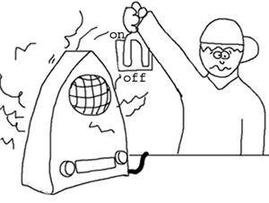
Smoke Testing
Smoke test is run on a new build of software to make sure all functions operate well enough to continue testing
“Turn on a new appliance at the store”

Slide 38

FAST Testing
Functional Acceptance Simple Tests
  Wide in breadth, low in depth
  Exercise every function of the application at least once

Slide 39
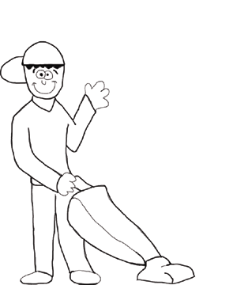
Regression Testing
Previously executed tests are re-executed against a new version of the application
  have code changes broken something that used to work
  have we introduced new defects
  often automated

Slide 40
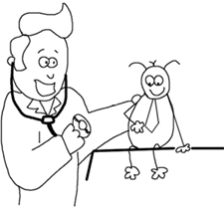
Confirmation Testing
Typically:
  Tester confirms that the fixed bug is really fixed in the appropriate software build

Slide 41
Getting Things Done
Testing Activities
Elaboration
Define test procedure and test cases.
Methods, techniques, test cases. All must be repeatable.
Exploration
Primarily to identify areas of weakness or instability!
Use exploratory testing techniques.
PLATFORM
Execution
Follow defined test procedures or execute automated test scripts.
While testing identify bugs! (use checklists!)
Bug Isolation
Narrow down how to repeat bug. Be practical.
May need triage to determine if more isolation is needed.
Track Progress
Track defects Open open over time. (TREND CURVE)
Track test chunk status over time. (SPREED SHEET)
Stress Test Experiment
Execute in collaboration with development.
As required report bugs and always report stress test results!

Slide 42
Just In Time Testing
Exploratory Testing

Slide 43
Getting Things Done
Wisdom
  Exploratory Testing in parallel with elaboration of chunks
  Elaborate higher priority chunks first
  Executing chunks as they are elaborated
  DO NOT WAIT FOR A COMPLETE SET

Slide 44
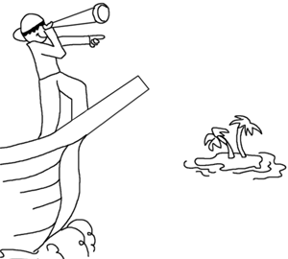
Exploratory Testing
Approach formalized by James Bach (www.satisfice.com)
Used in General Functionality and Stability Test Procedure for Windows 2000 Application Certification

Slide 45
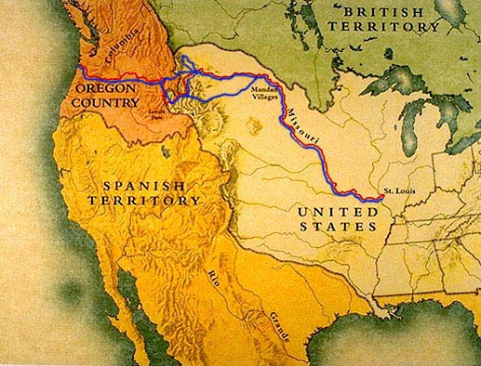
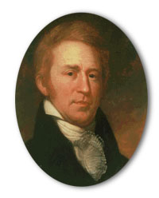
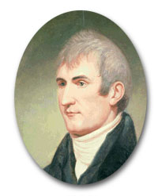
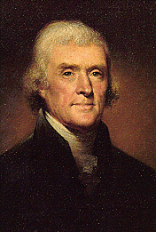
Mandate to explore
William Clark
Meriwether Lewis
The object of your mission is to explore the Missouri river,
& such principal streams of it, as, by its course and communication
with the waters of the Pacific ocean...may offer the most direct &
practicable water communication across this continent for the
purposes of commerce.
- Thomas Jefferson's letter to Meriwether Lewis, June 1803

Slide 46
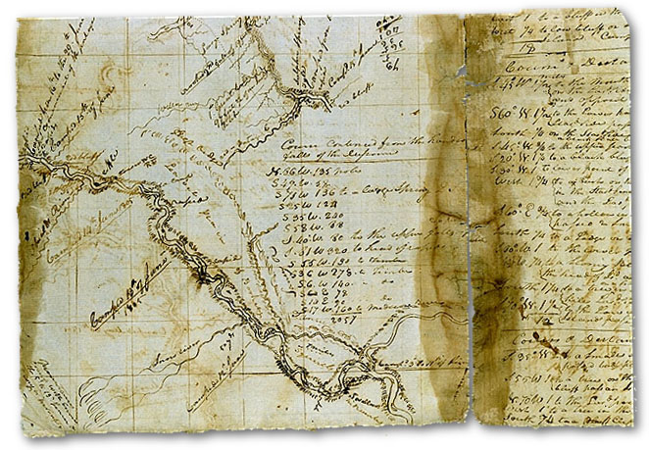
Make intelligent decisions
Take notes about your decisions
Map out where you have been
Others can use the result

Slide 47
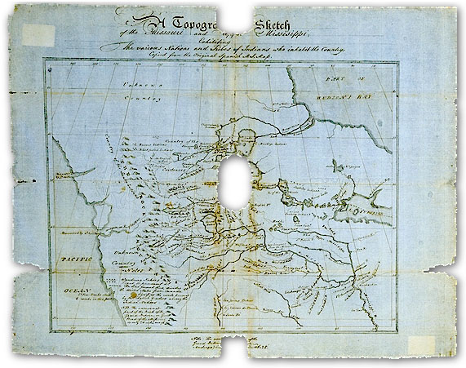
Chart as you explore
Further exploration yields a good idea of the state of the world!
One bit at a time

Slide 48
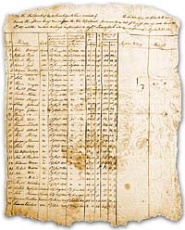
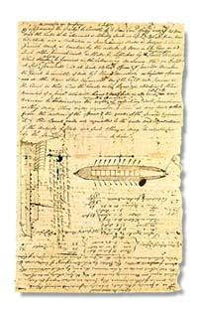
Exploration Notes
- Tabular
- Chronological
- Schematic
- Point form
- Concise

Slide 49
Exploratory Testing
Test cases
  Not known in advance
  Defined & executed “on the fly” while you learn about the product
Testers need to “hone up” their skills in making maps!
  Consistent note taking style
  Practice
We need to have a standard template
  Uniform way to capture details

Slide 50
Exploratory Testing
During test we must capture
  Function, options or sub-functions being explored
  Test cases attempted
  Comments, notes, images or attachments
  Hints, reminders and observations which may be useful to future testers
  Date, Platform, Build or Configuration under test
  Name of person running test
  Oracles, “strategy to assess correctness”
  Other relevant details

Slide 51


An Exploratory Test Process
Confirm Test Objective
Ensure context known
Ensure HW and SW OK
All tools available
Kick Off
Prepare
Chunk of 90 to 120 min
Test, Plan, Discover
Run
Wrap up
Collect all notes data
Complete
Review results with
Test Lead
Review
Reassess goals
Piece together map
Follow Up

Slide 52
Just In Time Testing
Scenarios

Slide 53
Scenario Based Testing
Scenarios
  Your testing department should develop a series of typical, real, usage scenarios for each user type
    Can be done in parallel with development effort
    Could be based on Use Case Analysis
    Could be based on Story Boards
  Testing chunks can be dedicated to scenario elaboration or execution
    Elaboration (scripting) by testing professionals
    Execution by contractors, students, support staff etc
    Lots of parallelism!
  Individual scenarios can cover many functions!

Slide 54
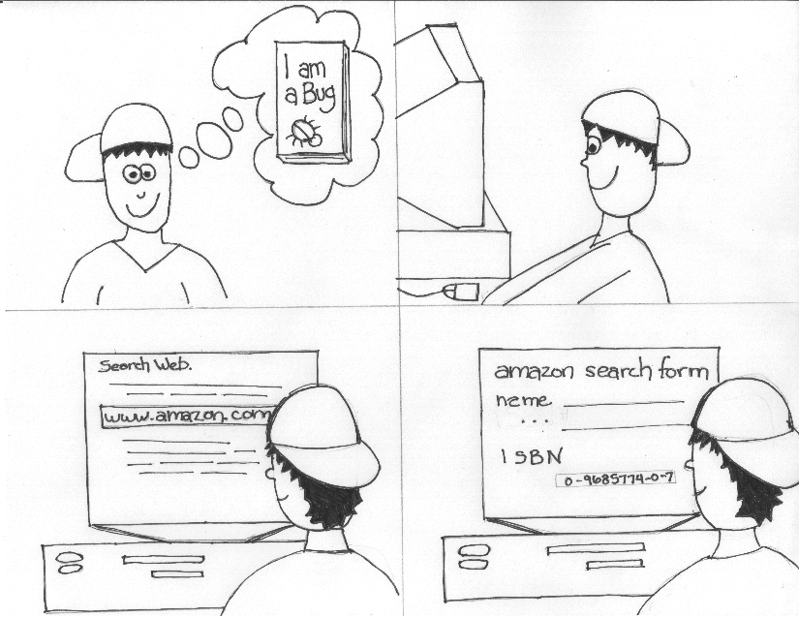

Slide 55
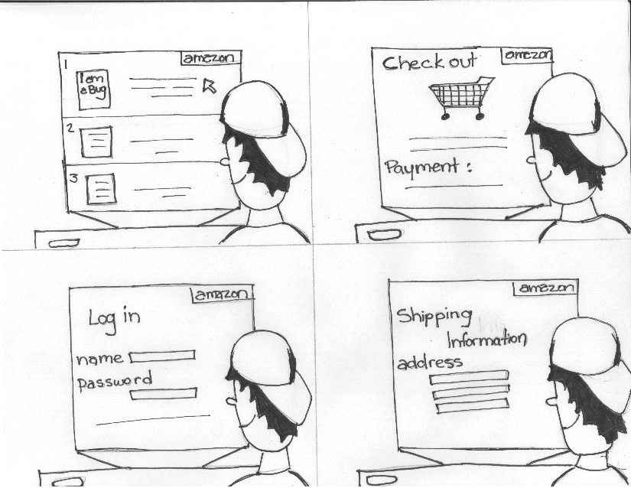

Slide 56
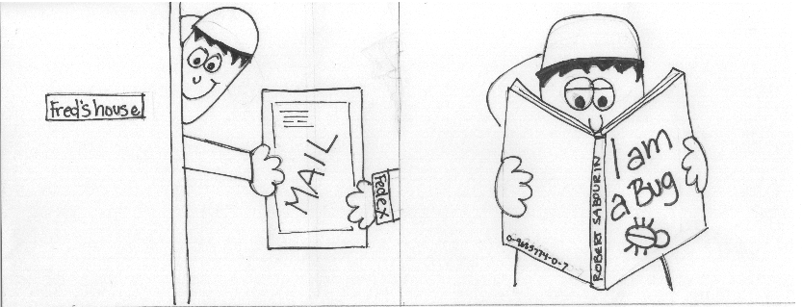

Slide 57
Scenario Based Testing
User Experience Test Case
  Parameterize experience
  Walk through scenario from start to end
  Use pre selected input for each case
  Always run every test as if it were a user experience

Slide 58
Just In Time Testing
Status

Slide 59
JIT Status
Reporting Status
  Test Objectives
  Test Results
  Scoreboard
  Bug Summary
  What we know
  What is left to do

Slide 60
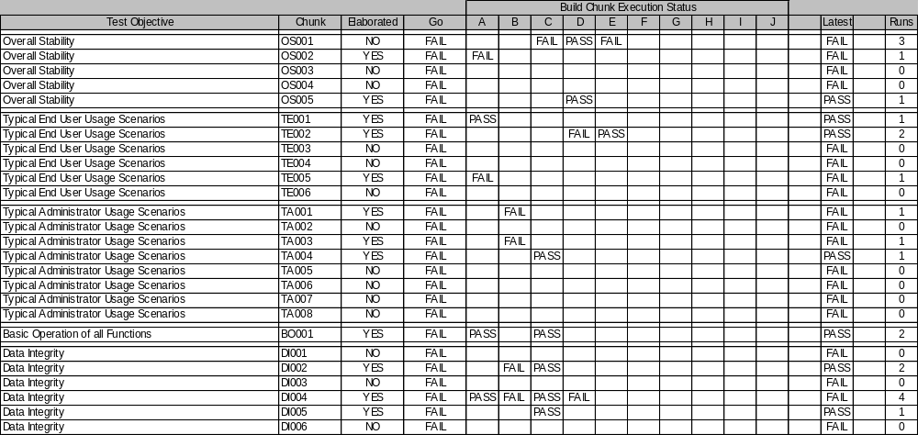
JIT Status

Slide 61
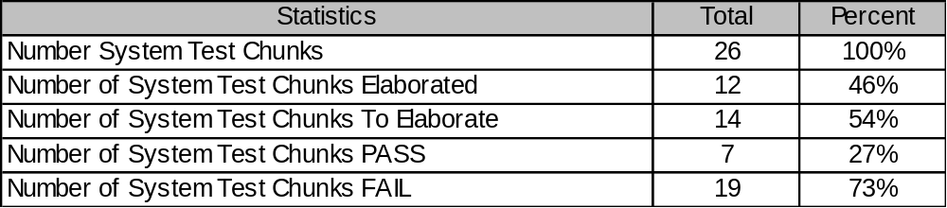
JIT Status

Slide 62
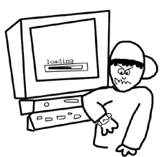
JIT Status
Test Lead Must Track Efforts Every Day!
Number of Tests to elaborate?
Number of Tests Passed?
Number of Tests Failed?
Number of High Priority Bugs to be fixed?
Number of Bug Fixes to confirm?
Count every day and plot trend graphs!
Publish results.

Slide 63
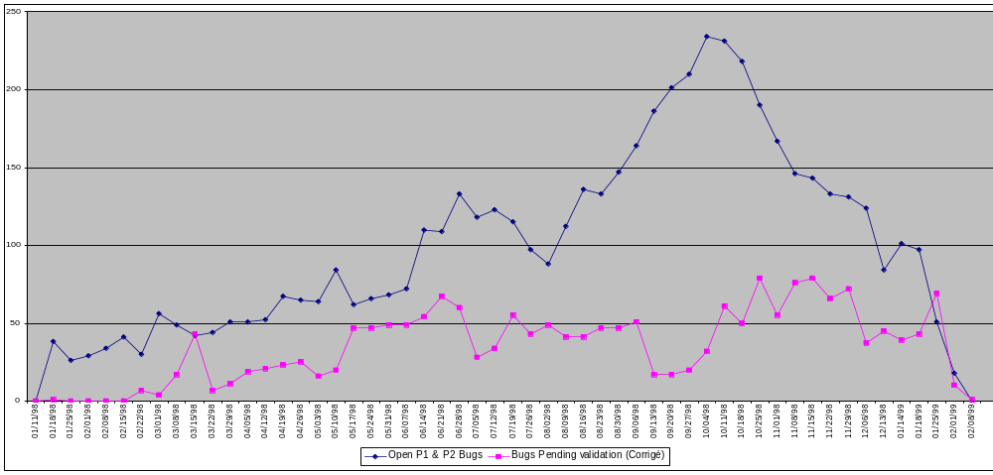
JIT Status
Trend Chart
Open Bugs

Slide 64
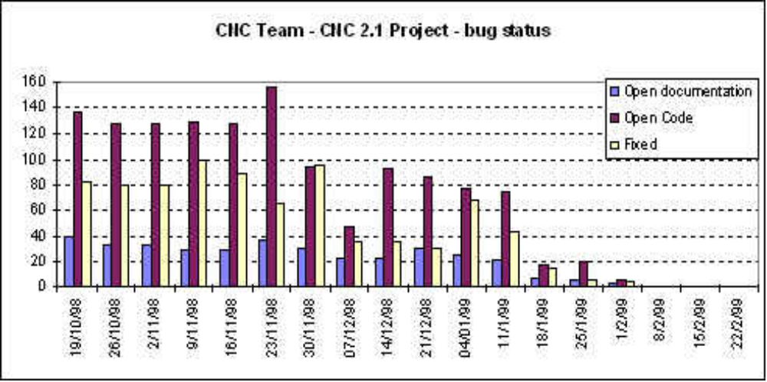
JIT Status
Trend Chart
Open Bugs By Type

Slide 65
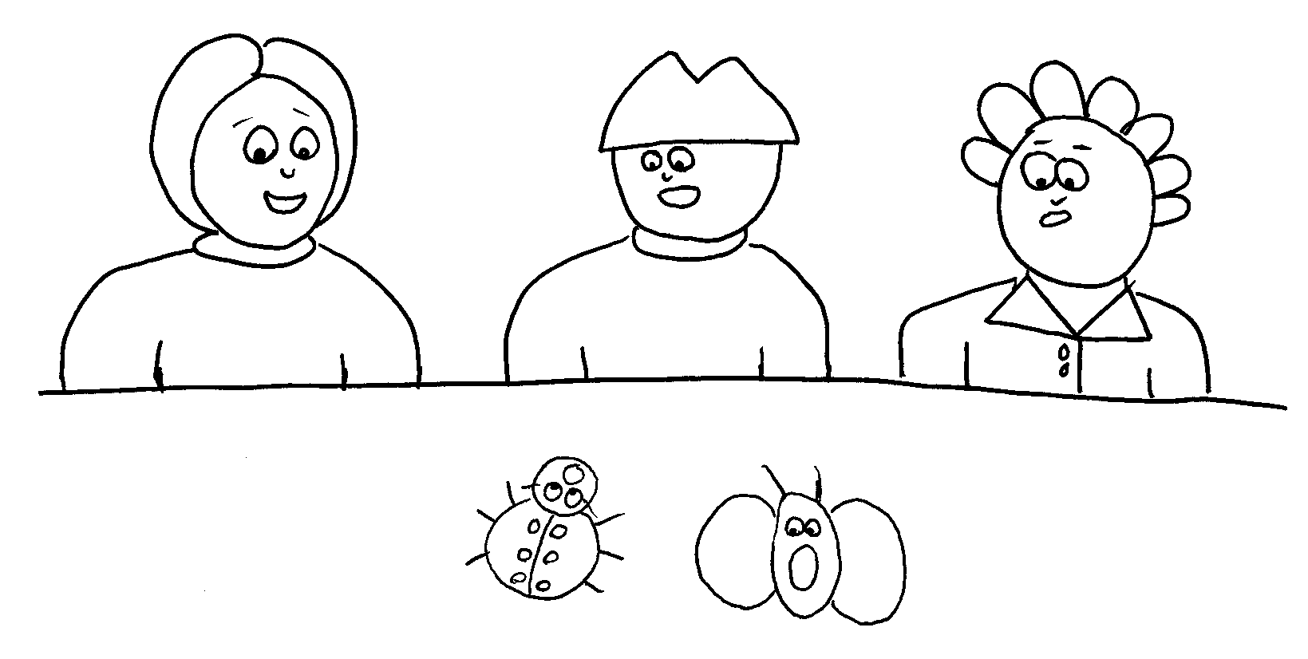
Finished?
How do you know you are finished?

Slide 66
You know you are finished when
…
… the only bugs left are the ones are acceptable (based on your objective test team input) ...

Slide 67

You know you are finished when
…
… the only bugs left are the ones are acceptable (based on your objective test team input) ...
At least for now!

Slide 68
Thank You
Questions?

